Slide 1
Astrophysicist
Maths in the workplace

Slide 2
How our teaching resources are designed for the classroom

Slide 3
I can understand how maths is used by astrophysicists.

Slide 4
An astrophysicist tries to understand the universe and its contents by applying the laws of physics.

Slide 5

Astrophysicist
Being an astrophysicist
Determining terrain features

Slide 6

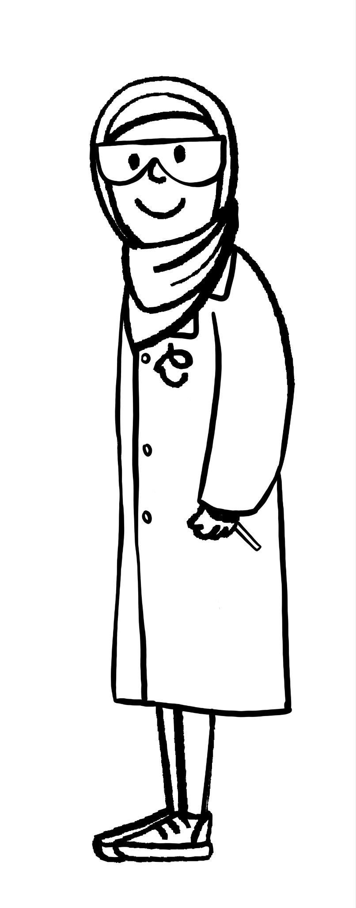
Being an astrophysicist
An astrophysicist tries to understand the universe and its contents by applying the laws of physics.
An astrophysicist tries to understand the universe and its contents by applying the laws of physics.
What are the contents of the universe?
Aisha

Slide 7
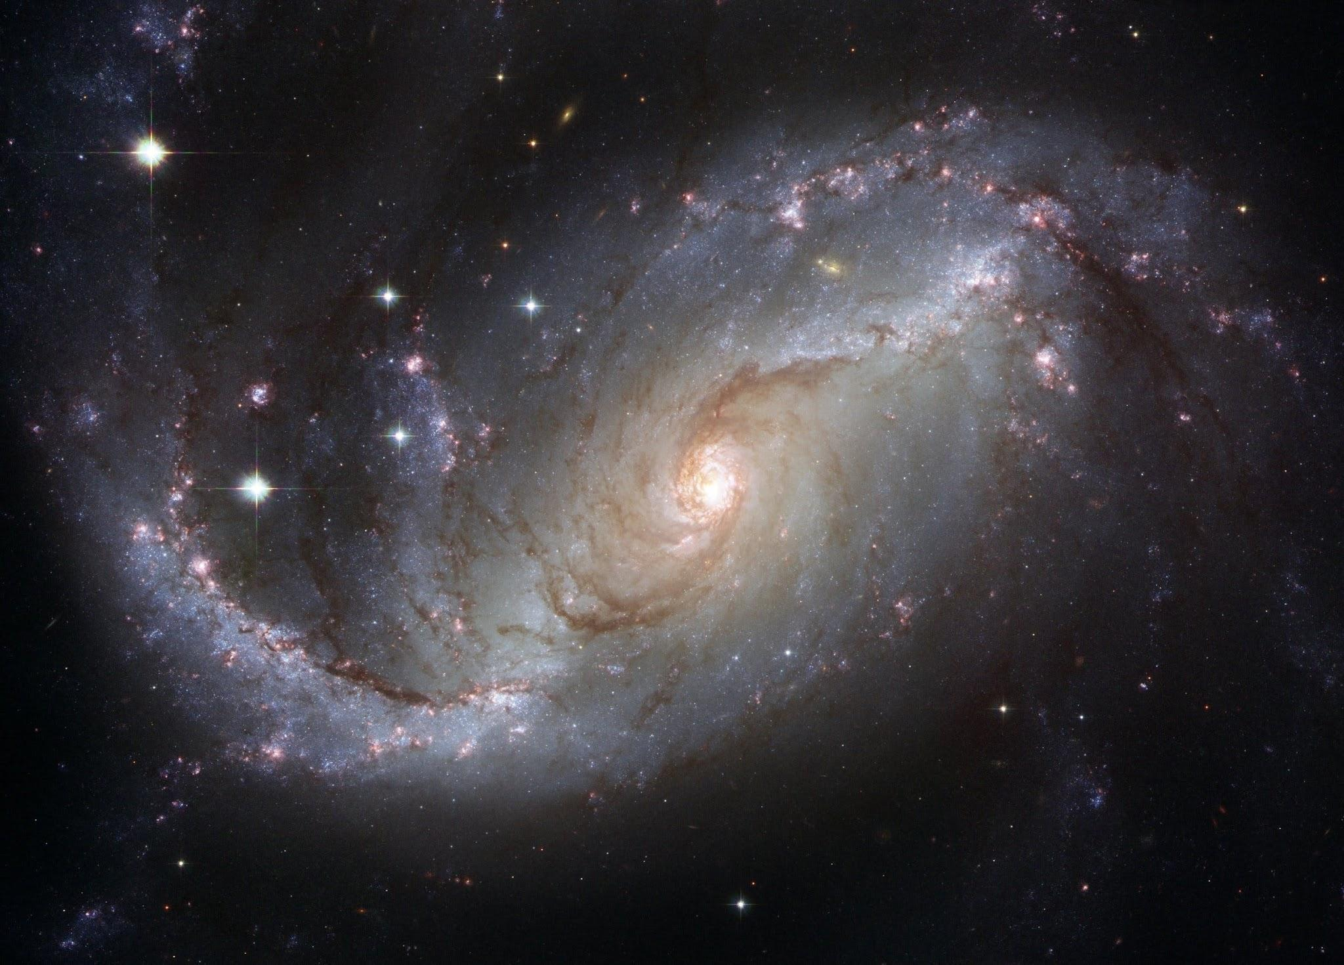
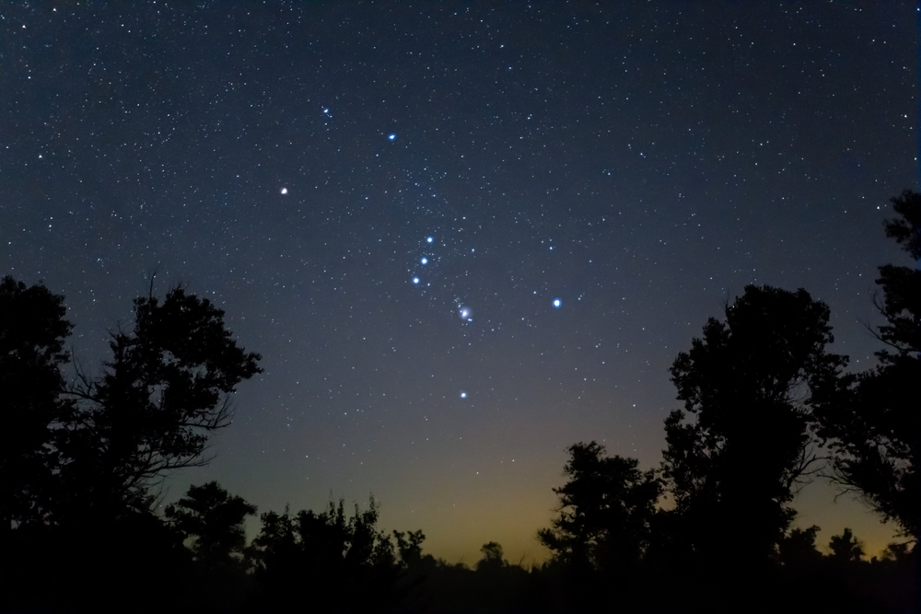
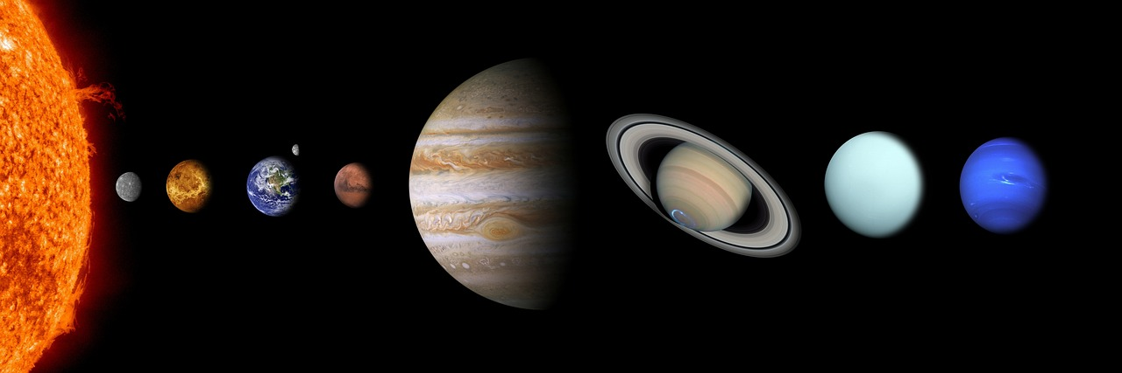
Being an astrophysicist
Moons
Comets
Asteroids
The list goes on!
Galaxies
Stars
Planets

Slide 8

Being an astrophysicist
An astrophysicist tries to understand the universe and its contents by applying:
the laws of biology
the laws of chemistry
the laws of economics
the laws of physics

Slide 9
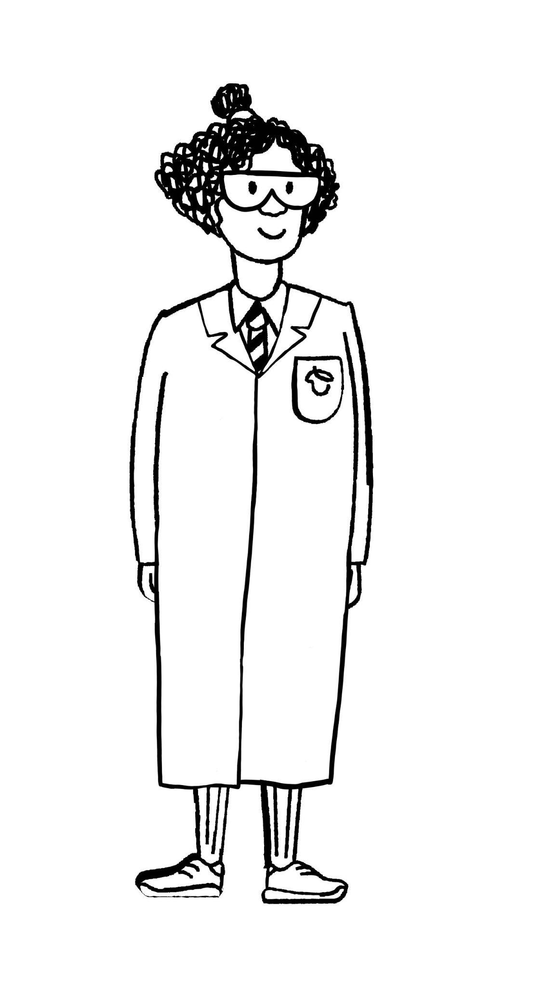
Being an astrophysicist
Are astrophysicists and astronomers the same thing?
Yes and no.
Izzy
Aisha

Slide 10
Being an astrophysicist
Astrophysics is a branch of astronomy.
Astronomers study the universe using observational techniques to assess and categorise various celestial bodies.
Astrophysicists have a more narrowed focus. They study the physics of the universe such as how the celestial bodies interact or other physical processes.

Slide 11
Being an astrophysicist
Astrophysicists often have to interpret data. This may involve converting between different types of unit of measurement and using formulas to find new data.
Standard form may be used if the values recorded are extremely large.

Slide 12
Being an astrophysicist
Standard form is when a number is written in the form:
A × 10^{n} (where 0 ≤ A < 10 and n is an integer).
A × 10^{n} (where 1 ≤ A < 10 and n is an integer).
A × 10^{n} (where 1 < A ≤ 10 and n is an integer).
A × 10^{n} (where 0 < A ≤ 9 and n is an integer).

Slide 13
Being an astrophysicist
Select the correct way of writing 5 834 000 000 000 in standard form.
5.834 × 10¹²
5 × 10¹²
5.834 × 10⁻¹²
5834 × 10⁻¹²

Slide 14
Being an astrophysicist
1) Fill in the gaps.
____ is a branch of astronomy. ____ study the universe using ____ ____ to assess and categorise various ____ bodies. Astrophysicists have a more ____ focus. They study the physics of the universe such as how the celestial _____ . interact or other ____ processes.
Astrophysics
bodies
narrowed
physical
Astronomers
celestial
observational
techniques

Slide 15
Being an astrophysicist
2) a) The table below shows the approximate average distances from Earth to some of the other planets in our solar system. Write the distances in standard form.
From | To | Distance (km) | Standard form
Earth | Mercury | 91 691 000
Earth | Venus | 41 400 000
Earth | Mars | 78 340 000
Earth | Jupiter | 628 730 000
Earth | Saturn | 1 275 000 000

Slide 16
Being an astrophysicist
2) b) In 2021, the fastest speed recorded by a spacecraft was 163 km/s. Using that speed and the formula
Distance = Speed × Time
To | Distance (km) | Time (days)
Mercury | 91 691 000
Venus | 41 400 000
Mars | 78 340 000
Jupiter | 628 730 000
Saturn | 1 275 000 000
Calculate how long it would take, in days, to travel from Earth to each planet.
Round your answer appropriately to the nearest day.

Slide 17
Being an astrophysicist
1) Fill in the gaps.
Astrophysics is a branch of astronomy.
Astronomers study the universe using observational techniques to assess and categorise various celestial bodies.
Astrophysicists have a more narrowed focus. They study the physics of the universe such as how the celestial bodies interact or other physical processes.

Slide 18
Being an astrophysicist
2) a) The table below shows the approximate average distances from Earth to some of the other planets in our solar system. Write the distances in standard form.
From | To | Distance (km) | Standard form
Earth | Mercury | 91 691 000 | 9.1691 × 10⁷
Earth | Venus | 41 400 000 | 4.14 × 10⁷
Earth | Mars | 78 340 000 | 7.834 × 10⁷
Earth | Jupiter | 628 730 000 | 6.2873 × 10⁸
Earth | Saturn | 1 275 000 000 | 1.275 × 10⁹

Slide 19
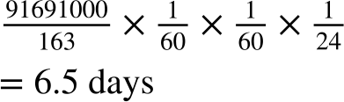
Being an astrophysicist
2) b) In 2021, the fastest speed recorded by a spacecraft was 163 km/s. Using that speed and the formula
Distance = Speed × Time
To | Distance (km) | Time (days)
Mercury | 91 691 000
Venus | 41 400 000
Mars | 78 340 000
Jupiter | 628 730 000
Saturn | 1 275 000 000
It will take more than 6 days so we round to 7 days.

Slide 20
Being an astrophysicist
2) b) In 2021, the fastest speed recorded by a spacecraft was 163 km/s. Using that speed and the formula
Distance = Speed × Time
To | Distance (km) | Time (days)
Mercury | 91 691 000 | 7
Venus | 41 400 000 | 3
Mars | 78 340 000 | 6
Jupiter | 628 730 000 | 45
Saturn | 1 275 000 000 | 91

Slide 21
Astrophysicist
Being an astrophysicist
Determining terrain features

Slide 22
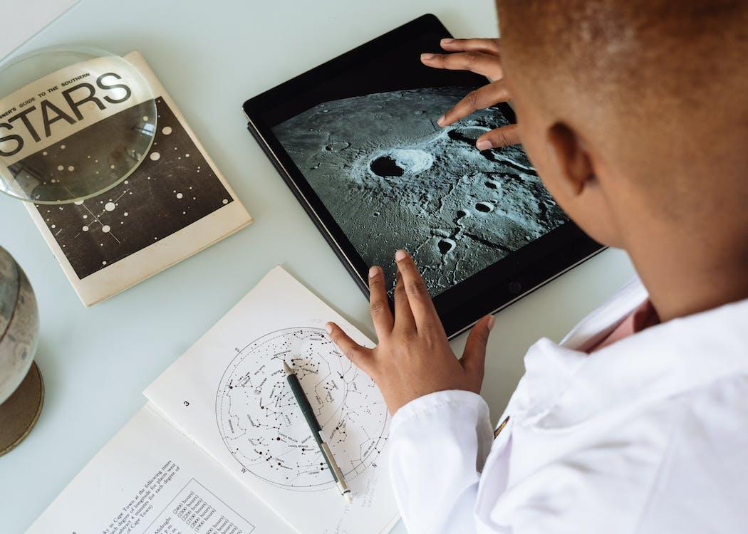
Determining terrain features
The first Moon landing took place in 1969. Since humans could walk on the Moon, it meant measurements could be taken on the Moon’s surface.
What sort of measurements might be useful to record?

Slide 23
Determining terrain features
Calculating the height of various features (such as mountains) is often done using a laser altimeter.
However, not all space missions have one.
In those cases, we can still determine an estimate for the height of various features using trigonometry.

Slide 24
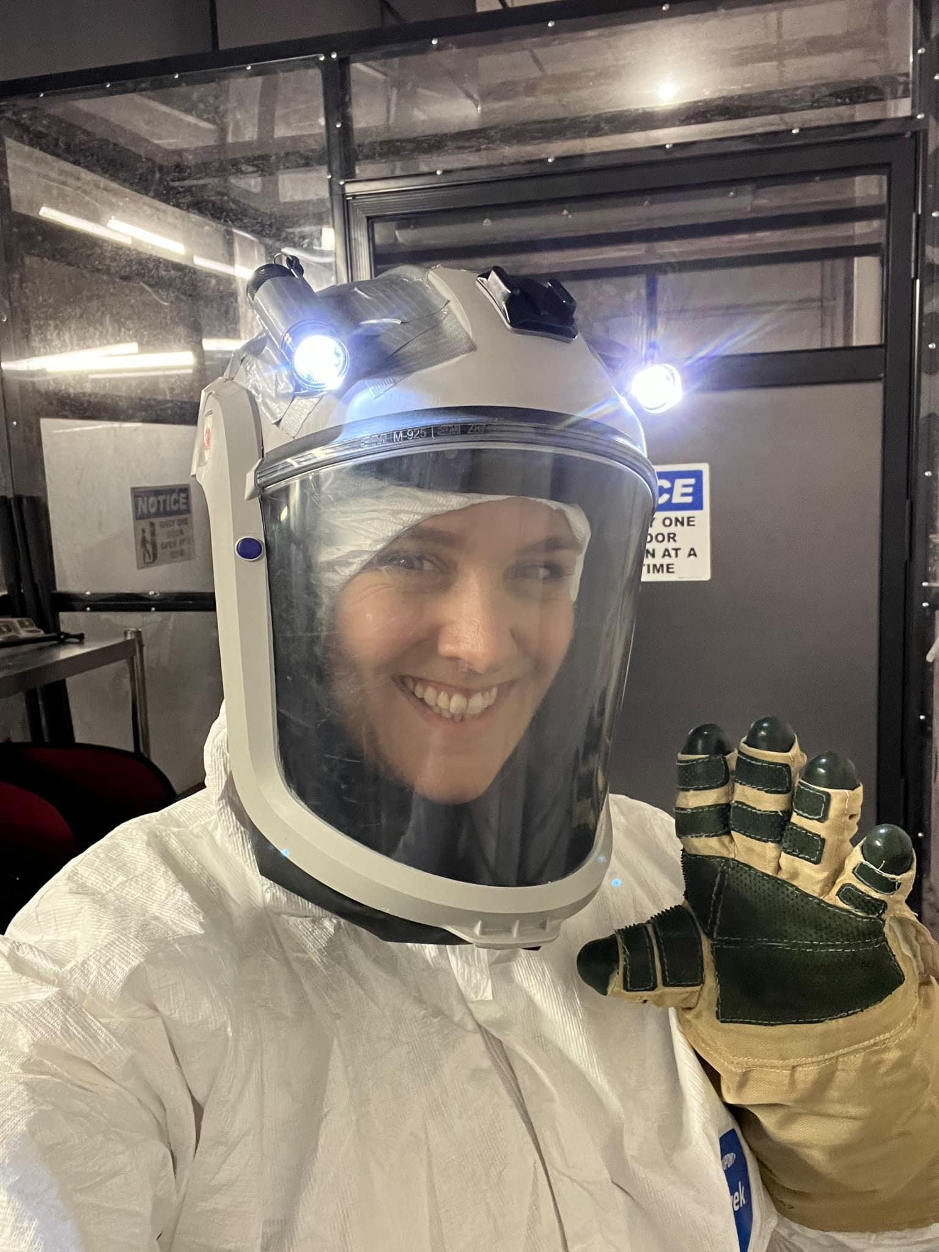
Determining terrain features
Simulations can be run on Earth to help study features on other planetary bodies.
This is Professor Veronica Bray, PhD.
She is an associate research professor.
She is dressed like this because she is carrying out a simulation with her colleagues.

Slide 25
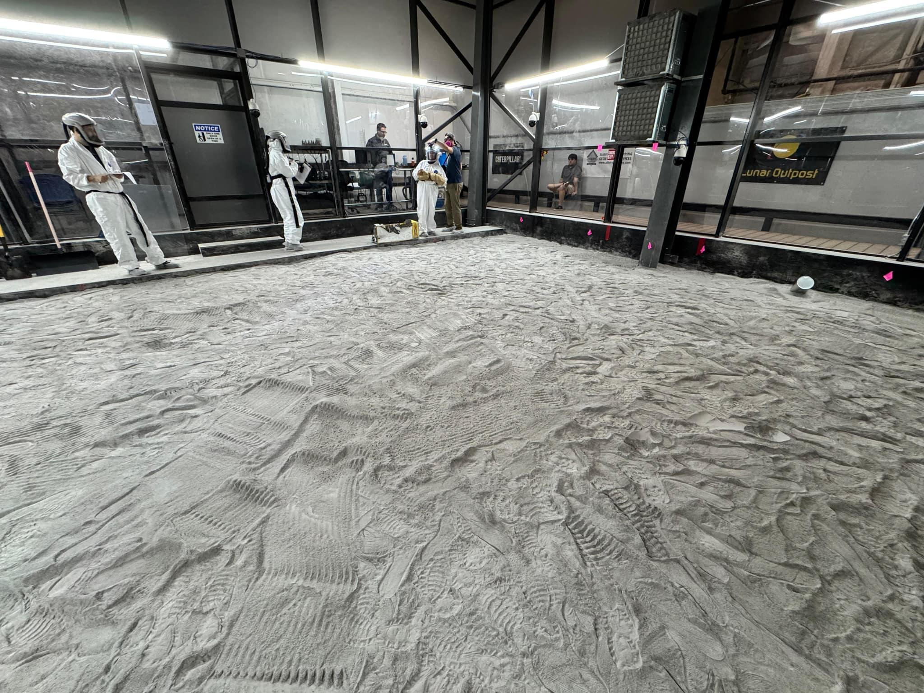
Determining terrain features
They are simulating the Artemis astronaut conditions at the South Pole of the Moon.
Professor Bray and her colleagues are recreating the correct lighting conditions for astronaut training.

Slide 26
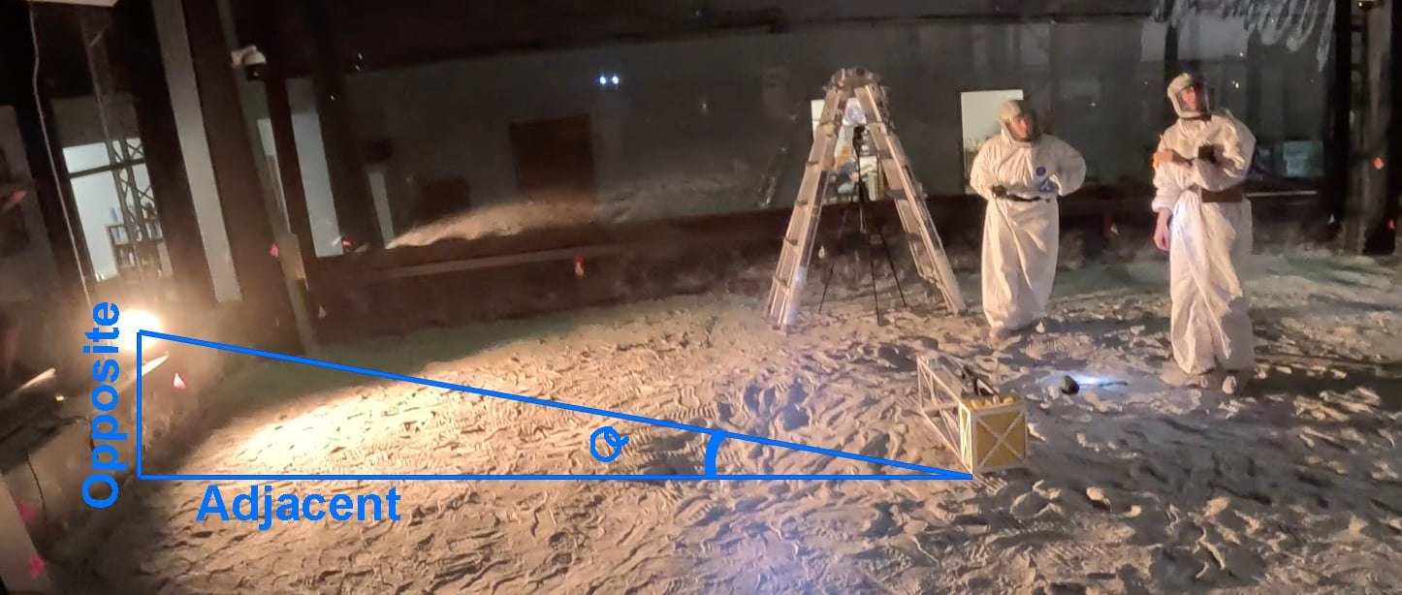
Determining terrain features
They need to know the Sun angle (𝜃°) so they can calculate the correct ratio of the height (opposite) of the light source and the distance (adjacent) from the feature.

Slide 27
Determining terrain features
Mountains on the Moon were formed through massive asteroid impacts. These impacts resulted in the craters we can see. The walls of the craters can be very high.

Slide 28
Determining terrain features
To estimate the height of the crater wall at the selected point, we can use trigonometry.
We will need to know:
the length of the shadow
the angle the Sun is at

Slide 29
Determining terrain features
A sketch will simplify what we are considering.
Sun
sunlight
feature
surface

Slide 30
Determining terrain features
We will need to know:
the length of the shadow
the angle the Sun is at
Sun
sunlight
feature
𝜃°
surface
shadow

Slide 31
Determining terrain features
The length of the shadow can be measured from an image as long as the scale is known.
The angle of the Sun can be determined if we known when the image was recorded.

Slide 32
Determining terrain features
Given the length of the shadow and the angle of the Sun are known, what can be used to determine the height of the feature?
Sun
sunlight
Pythagoras’ theorem
feature
Similar triangles
𝜃°
shadow
Trigonometry

Slide 33
Determining terrain features
When the angle of the Sun is 42°, the length of the shadow is recorded as 7300 m. What is the height of the crater wall?
When the angle of the Sun is 87°, the length of the shadow is recorded as 346 m. What is the height of the crater wall?
Sun
sunlight
Sun
sunlight
feature
feature
42°
87°
7300
346
7300 × tan(42°) = 6572.9495…
≈ 6.6 km
346 × tan(87°) = 6602.0732…
≈ 6.6 km

Slide 34
Determining terrain features
1) Calculate the value (to 1 d.p.) of the unknown measurement in each case.
a) 𝜃° = 19°, a = 56 cm, b =
b) 𝜃° = 56°, a = 19 cm, b =
c) 𝜃° = 19°, b = 56 cm, a =
d) 𝜃° = 56°, b = 19 cm, a =
e) a = 56 cm, b = 19 cm, 𝜃° =
f) a = 19 cm, b = 56 cm, 𝜃° =
Not drawn accurately
b
𝜃°
a

Slide 35
Determining terrain features
2) The wall of a crater on Mars is 1.2 km tall. When the wall casts a shadow with length 557 m, what angle (to 1 d.p.) is the Sun at?
3) Another crater on Mars has a wall which casts a shadow of length 21 m. This occurs when the Sun is at an angle of 67°. What is the height (to 2 d.p.) of this wall?

Slide 36
Determining terrain features
4) The largest crater on the near side of the Moon is called Clavius. The walls of this crater are 6.6 km high.
Calculate three pairs of values for the angle of the Sun and the corresponding length of the shadow cast by the crater wall.
E.g. When the angle of the Sun is 42°, the length of the shadow is recorded as 7300 m.
When the angle of the Sun is 87°, the length of the shadow is recorded as 346 m.

Slide 37
Determining terrain features
5) In order to calculate an estimate for the height of a crater wall, we have produced a model/sketch of the situation.
State an assumption that we have made that may affect the accuracy of our estimated value.

Slide 38
Determining terrain features
1) Calculate the value (to 1 d.p.) of the unknown measurement in each case.
a) 𝜃° = 19°, a = 56 cm, b = 19.3 cm
b) 𝜃° = 56°, a = 19 cm, b = 28.2 cm
c) 𝜃° = 19°, b = 56 cm, a = 162.6 cm
d) 𝜃° = 56°, b = 19 cm, a = 12.8 cm
e) a = 56 cm, b = 19 cm, 𝜃° = 18.7°
f) a = 19 cm, b = 56 cm, 𝜃° = 71.3°
Not drawn accurately
b
𝜃°
a

Slide 39
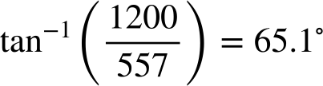
Determining terrain features
2) The wall of a crater on Mars is 1.2 km tall. When the wall casts a shadow with length 557 m, what angle (to 1 d.p.) is the Sun at?
3) Another crater on Mars has a wall which casts a shadow of length 21 m. This occurs when the Sun is at an angle of 67°. What is the height (to 2 d.p.) of this wall?
21 × tan(67) = 49.47 m

Slide 40
Determining terrain features
4) The largest crater on the near side of the Moon is called Clavius. The walls of this crater are 6.6 km high.
Calculate three pairs of values for the angle of the Sun and the corresponding length of the shadow cast by the crater wall.
There are infinitely many pairs that will work here. To check if your values are correct, perform this calculation:
length of shadow × tan(angle of Sun)
Your answer should round to 6.6 (if in km) or 6600 (if in m).

Slide 41
Determining terrain features
5) In order to calculate an estimate for the height of a crater wall, we have produced a model/sketch of the situation.
State an assumption that we have made that may affect the accuracy of our estimated value.
A possible assumption:
We assumed that the surface of the planet was flat when it is actually curved.

Slide 42
Astrophysicist
An astrophysicist tries to understand the universe and its contents by applying the laws of physics.
Astrophysicists often have to interpret data. This may involve converting between different types of unit of measurement and using formulas to find new data.
Trigonometry can be used to estimate the height of different terrain features on other celestial bodies.

Slide 43

© Oak National Academy 2024.
Produced in partnership with Mathematics in Education and Industry.
Licensed on the Open Government Licence v3.0, except where otherwise stated. See Oak terms and conditions.

